Slide 1
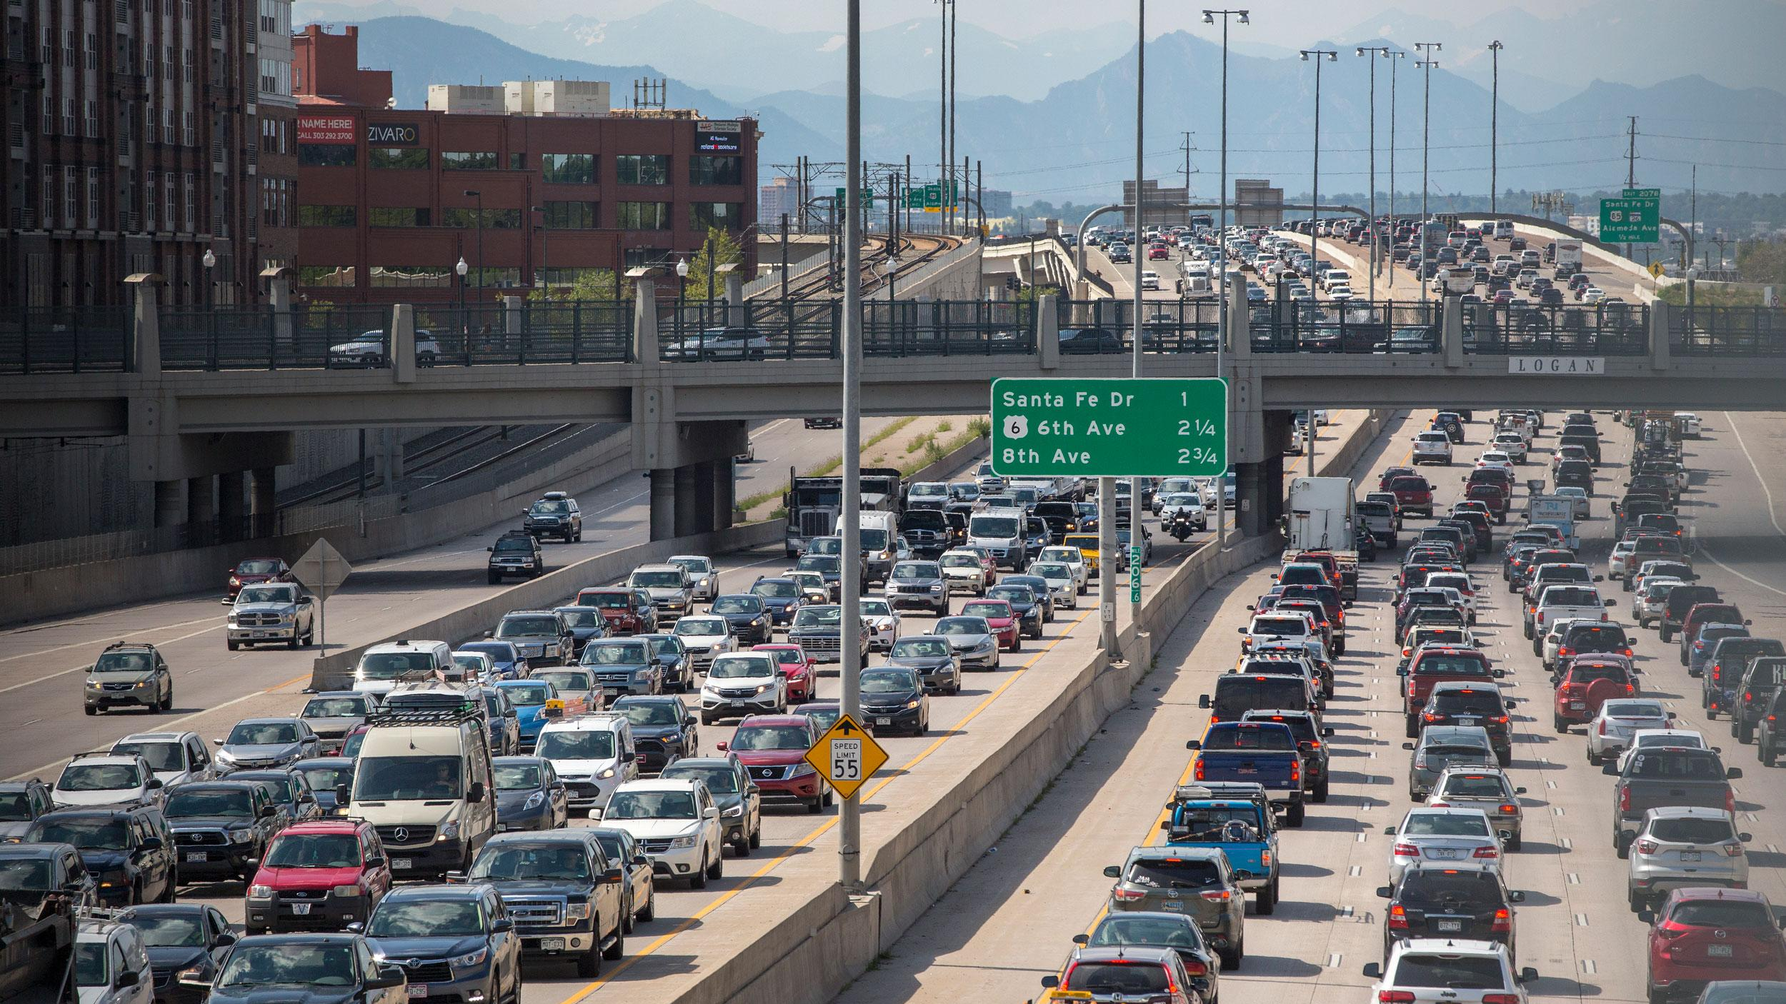


The Evolution of Ozone’s Weekday-Weekend Effect Across Colorado’s Front Range
2024 REU Symposium
30 July, 2024
Grace Servia
Collett Group | Andrey Marsavin, Dr. Amy Sullivan, Dr. Jeff Collett
Notes:
https://www.cpr.org/show-episode/oct-7-2019-ride-along-with-head-of-cdot-designing-future-moon-missions-in-colorado/
https://brand.colostate.edu/symbol/
https://www.nsf.gov/news/mmg/mmg_disp.jsp?med_id=184375
https://www.clipartmax.com/middle/m2H7N4d3b1A0Z5A0_metro-state-university-denver/

Slide 2

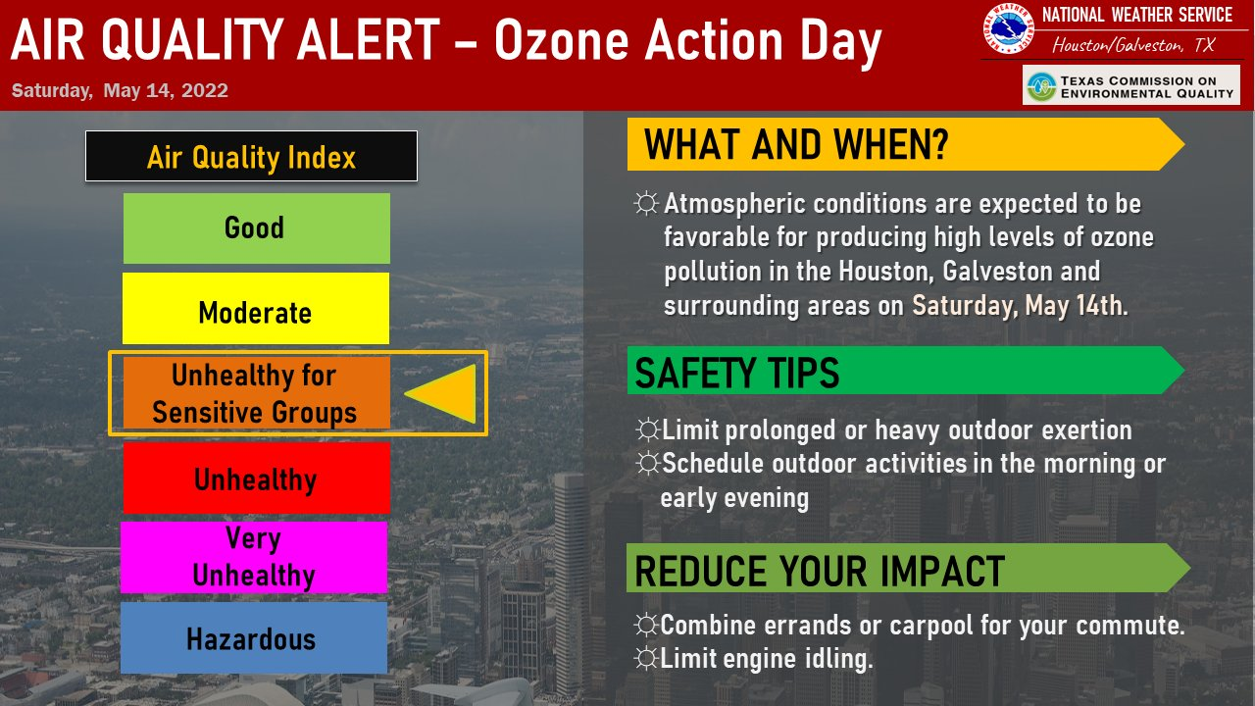

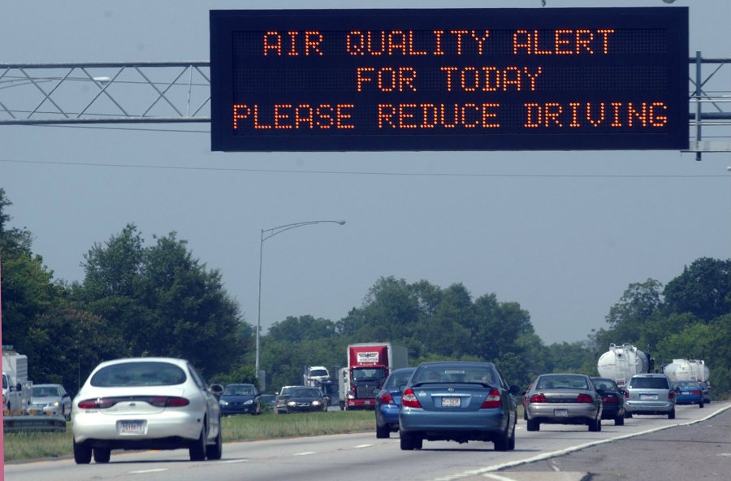

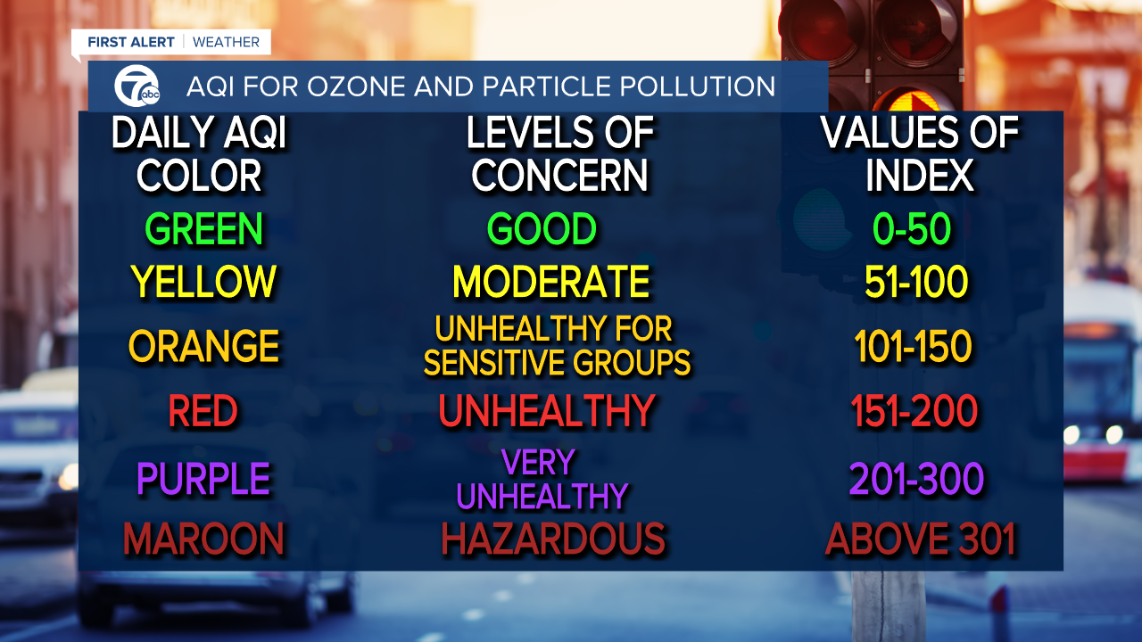
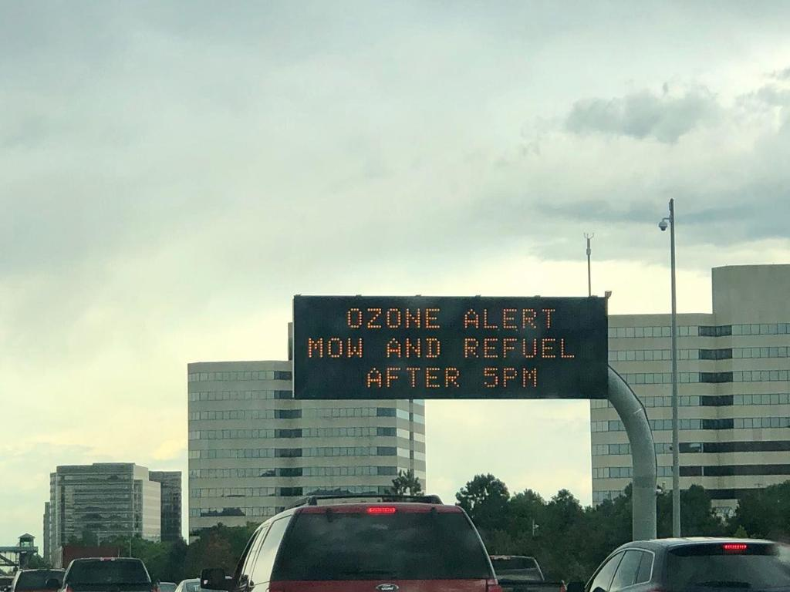
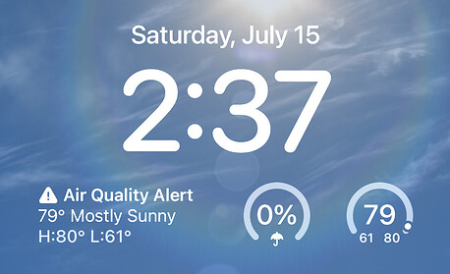
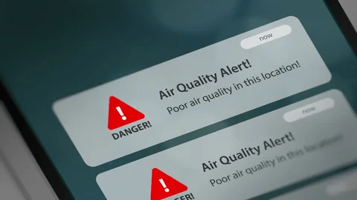
Notes:
https://www.wkbw.com/weather/air-quality-alerts-and-what-it-means-for-you
https://ziolkowski.eco/?y=air-quality-decreases-wednesday-as-temperatures-approach-triple-digits;-3-ll-vpJ qMC
https://ziolkowski.eco/?y=air-quality-decreases-wednesday-as-temperatures-approach-triple-digits;-3-ll-vpJ qMC
https://www.shutterstock.com/video/search/air-quality-monitoring
https://www.wktv.com/news/governor-unhealthy-air-quality-alert-cell-phone-alerts-n95-style-masks-available/article_17dd6d78-24ca-11ee-b6f5-abd6d4ae2379.html
https://forums.wyze.com/t/time-on-ios-notifications-is-wrong/30963/21?page=2
https://www.campussafetymagazine.com/news/leveraging-mass-notification-and-ai-to-detect-environmental-hazards/135285/
https://www.greeleytribune.com/2023/07/09/denver-colorado-ozone-alert-air-quality-pollution-highlands-ranch-golden/
https://denvergazette.com/outtherecolorado/news/unhealthy-air-prompts-ozone-alert-in-parts-of-colorado/article_64391b8c-54b4-5ada-bdc7-2e643fa28b6a.html
https://www.mainepublic.org/health/2018-06-28/report-on-air-quality-in-maine-has-environmentalists-concerned

Slide 3


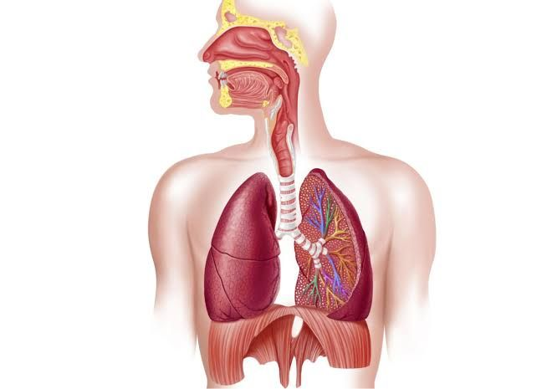
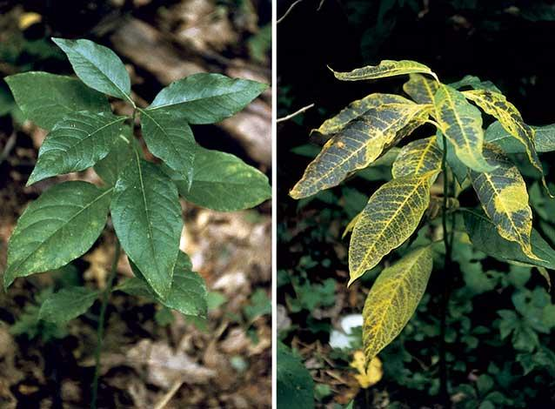


What is O₃?
O
O
O
Molecule composed of three Oxygen atoms
Ground level ozone is in the troposphere
Public health and environmental risk
Hazardous air pollutant, especially for children and the elderly, individuals with pre existing conditions, or who exercise outdoors
Leads to short and long-term consequences ranging from shortness of breath to premature death
Prevents plants from breathing and reduces agricultural yield and overall biomass
Degrades everyday materials such as rubber and plastics
Helmig,
2020
3
Notes:
https://en.wikipedia.org/wiki/Ozone
https://prode.clubtalleres.com.ar/?w=over-the-counter-inhalers-ss-KlgZqjcL
https://www.nps.gov/articles/parkscience_32_1_71-79_bingham_porter_3825.htm
https://www.brooksrunning.com/en_us/blog/gear-stories/running-outside-gear-guide.html
https://en.wikipedia.org/wiki/Ozone_cracking
https://pixers.us/posters/colorful-cartoon-city-landscape-43008203
https://amazon.com/Cutaway-diagram-respiratory-Leonello-CalvettiStocktrek/dp/B07C3133FR

Slide 4





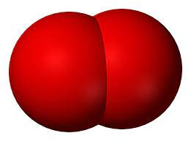

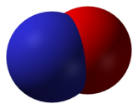
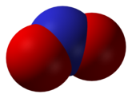

O₃ Lifecycle
hv
(light)
O₂
VOCs
NO
NO₂
Oᣟ
O₃
(emissions)
Precursor compounds such as nitrogen oxides (NO_{x}) and volatile organic compounds (VOCs) react with one another in the presence of sunlight to create O₃.
4
Helmig, 2020
Notes:
https://stock.adobe.com/search/images?k=cartoon+car+exhaust
https://en.wikipedia.org/wiki/Nitrogen_dioxide
https://pngtree.com/so/drop-clipart
https://depositphotos.com/vectors/natural-gas.html
https://www.hiclipart.com/free-transparent-background-png-clipart-dgxqb
https://www.istockphoto.com/photos/bank-of-paint-paint-brush-and-paint-roller
https://www.vecteezy.com/free-vector/lawn-mower
https://stock.adobe.com/search?k=sun+cartoon
https://en.wikipedia.org/wiki/Nitric_oxide
https://www.chem.ucla.edu/~harding/IGOC/H/hydroxyl_radical.html
https://en.wikipedia.org/wiki/Oxygen
https://en.wikipedia.org/wiki/Ozone
https://www.acs.org/middleschoolchemistry/lessonplans/chapter5/lesson1.html
https://commons.wikimedia.org/wiki/File:Hydroperoxyl_radical_spacefill.png

Slide 5
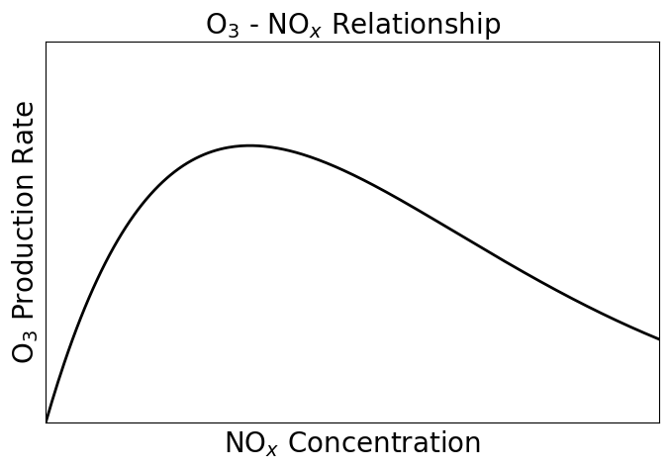
O₃-NO_{x} Relationship
O₃ production has a non- linear relationship with the amount of NO_{x} present in the air.
5
Schroeder et al., 2017
Notes:
Oxone production has a nonlinear relationship with nox production

Slide 6
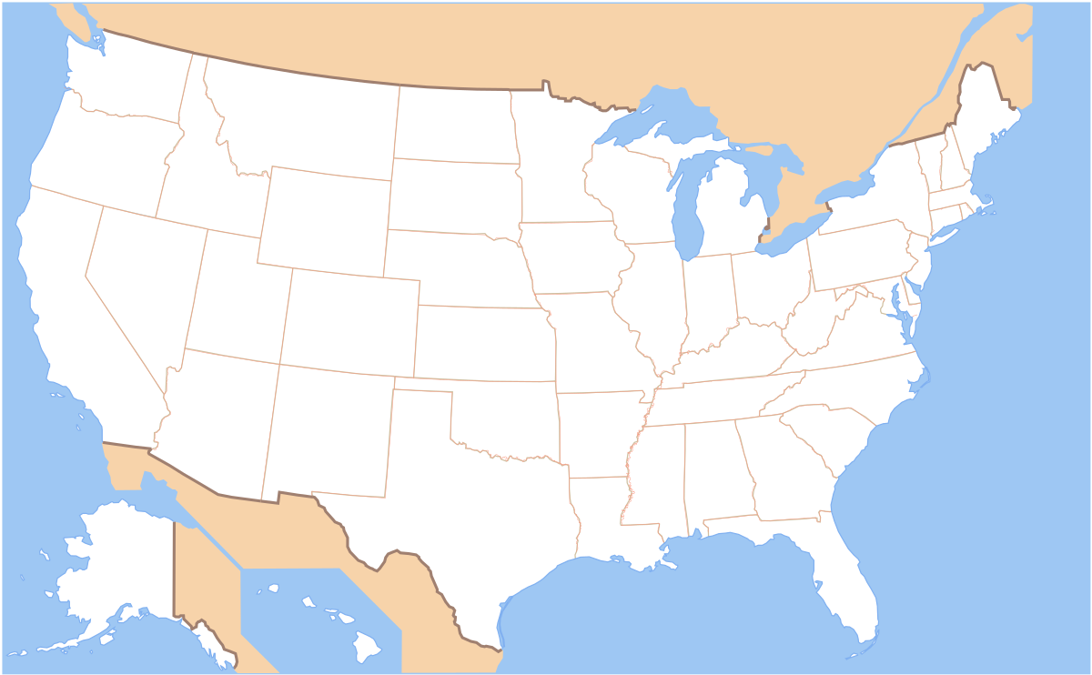
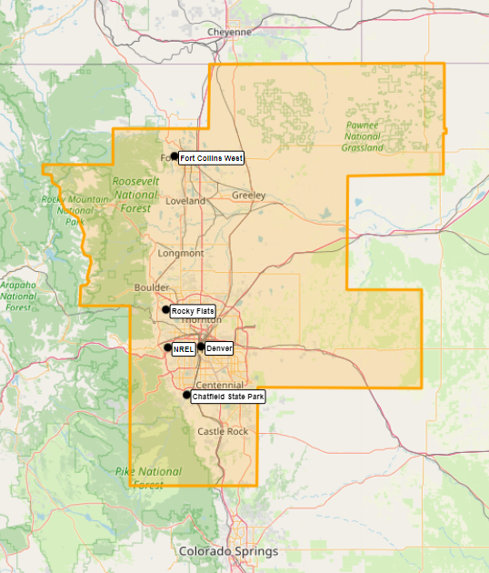
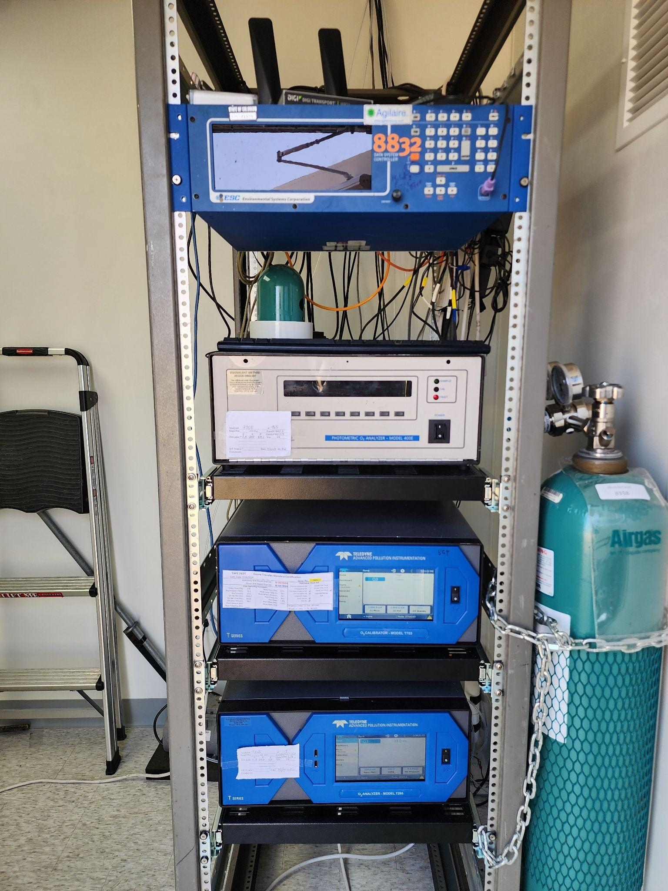


Colorado O₃
EPA has established National Ambient Air Quality Standards (NAAQS) for several air pollutants including O₃
The Colorado Front Range routinely exceeds the O₃ NAAQS (70 ppbv) and is designated as a nonattainment area
O₃ monitoring sites operated by CDPHE
Nonattainment area
6
Simon et al., 2024
Notes:
https://nihsepa.org/resource/environmental-protection-agency-epa/
https://data-cdphe.opendata.arcgis.com/
https://commons.wikimedia.org/wiki/File:Map_of_USA_without_state_names.svg

Slide 7
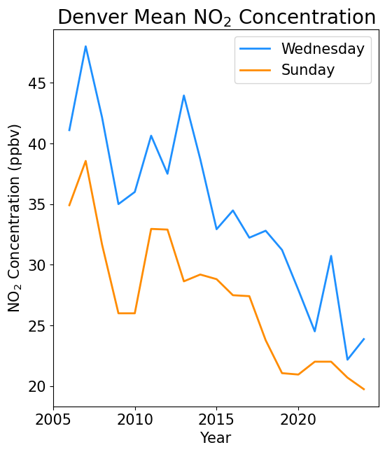

Investigating the Precursors
Regulations on precursor emissions have been implemented to mitigate O₃
NO_{x} emissions follow daily commuting patterns
Weekday-
Weekend Effect
Declining NO_{x} concentrations
7
Data: CDPHE 2005-2023
Notes:
When we look at these precursor trends, this is what we find
https://www.cpr.org/2019/10/15/denvers-traffic-is-bad-and-a-new-report-says-itll-only-get-worse/
#Since we can see that the O3 is trending oddly, the next step is to investigate the precursors

Slide 8
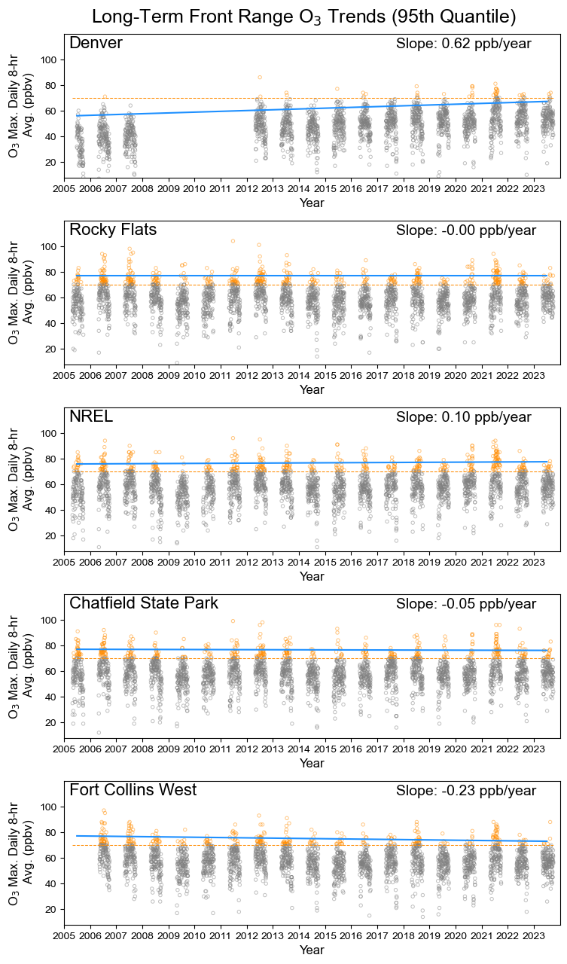
The O₃ Quandary
70 ppbv NAAQS
95th quantile trend
Across the Front Range, there is no discernable trend in O₃ concentrations and exceedance days are still occuring!
8
Data: CDPHE 2005-2023

Slide 9
Back to the Drawing Board
Concentrations of the NO_{x} precursor have been dropping
Could investigating a weekday-weekend difference in O₃ help inform us more about O₃’s response to
changing NO_{x}?
NO_{x} follows a weekday-weekend trend
O₃ concentrations have not been dropping in the same way as NO_{x}’s
9

Slide 10
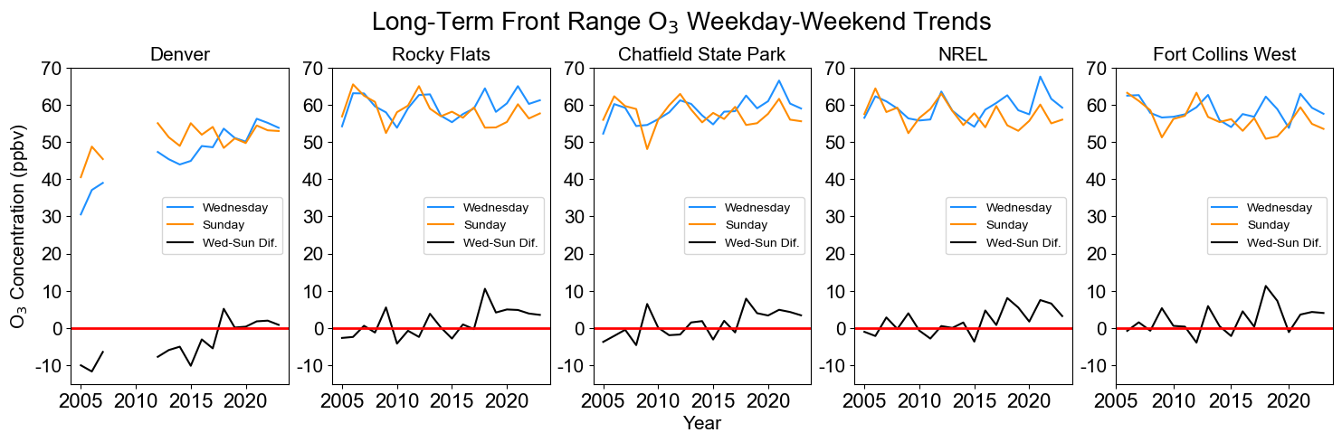
Long-Term O₃ Weekday-Weekend Behavior
O₃’s weekday-weekend difference oscillates around 0 until it begins to trend positive around 2017
10
Data: CDPHE 2005-2023
Notes:
NOx had declined steadily and maintained positive weekday-weekend values, so we know that O3 is not simply following NOx behavior

Slide 11
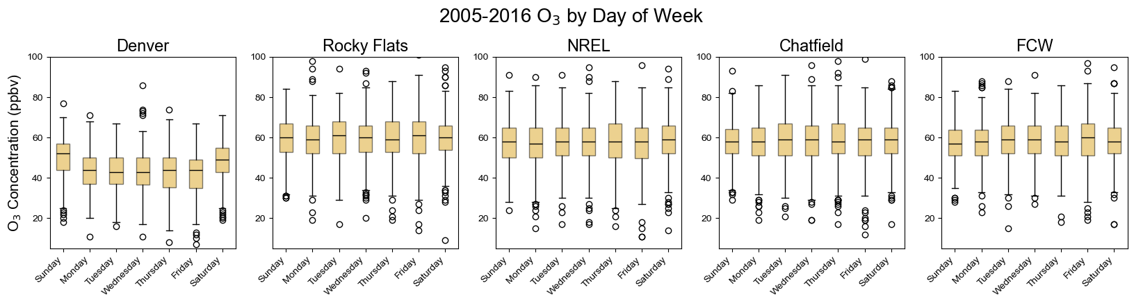
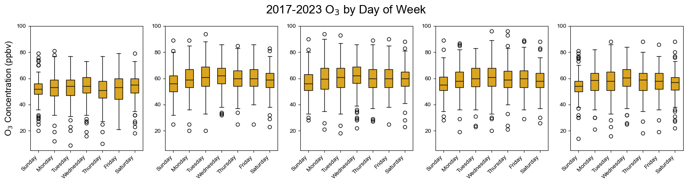
O₃ Weekday-Weekend Development
Data:
CDPHE
2005-2023
O₃ is more readily forming in the presence of NO_{x} even though less NO_{x} is present in the atmosphere!
11
Notes:
A weekday-weekend effect develops despite decreasing NOx concentrations!

Slide 12
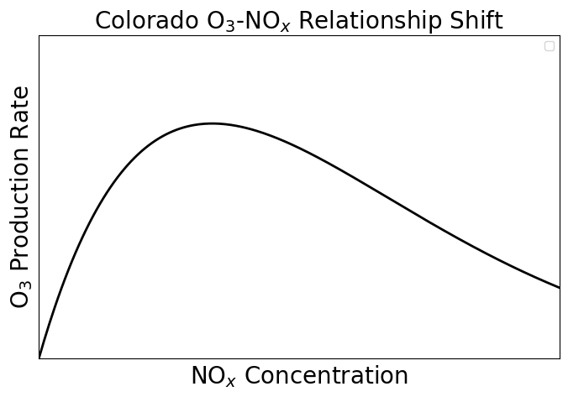
A Shift in O₃ Sensitivity
In the past, O₃ production decreased with increasing NOx concentrations. Now, O₃ is increasing with increasing NOx concentrations
O₃’s sensitivity to NOx is increasing
Can help inform new regulations and technology: continued NO_{x} emission reductions will result in less O₃ production
“NOx - limited”
(2017-2023)
“NOx - saturated”
(2005-2016)
12
Notes:
A weekday-weekend effect develops despite decreasing NOx concentrations!

Slide 13
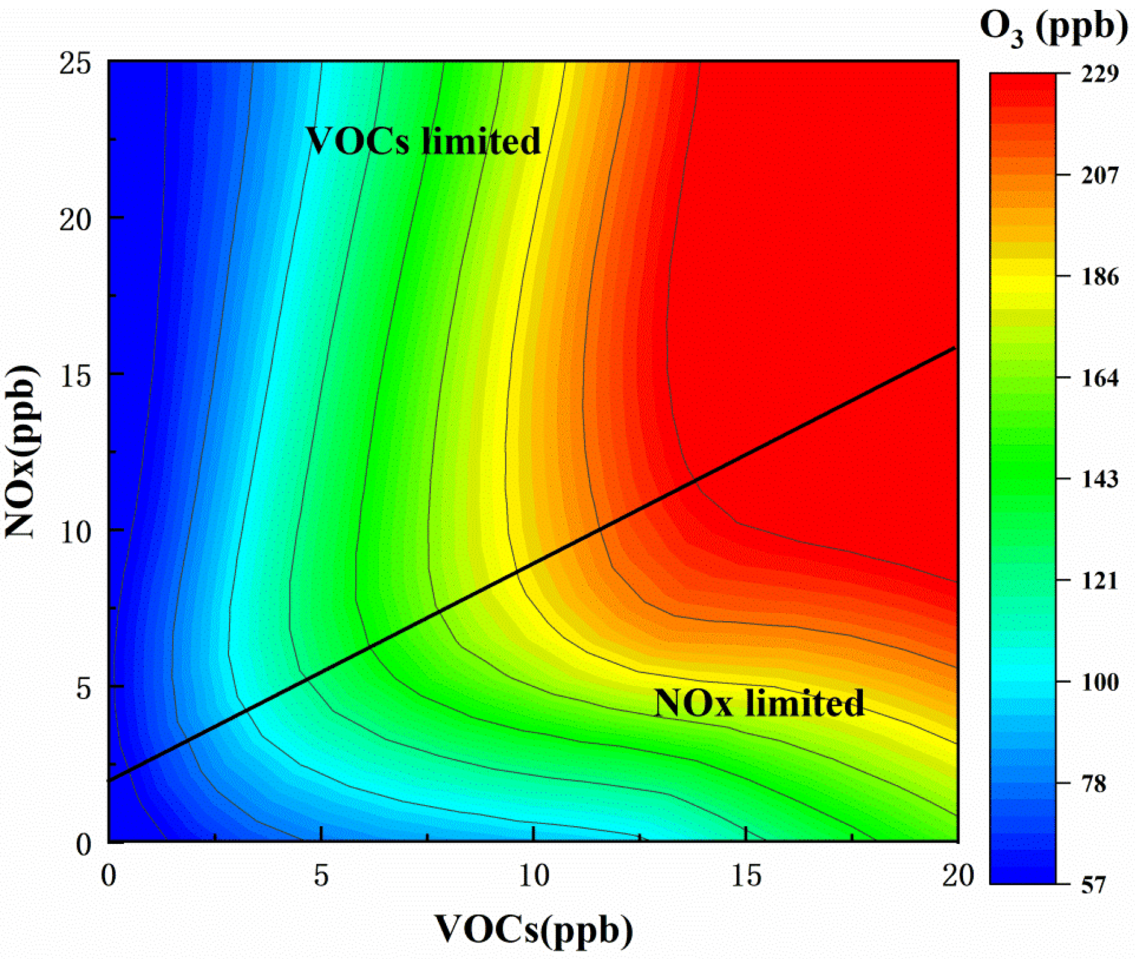
Future Work and Limitations
Assumes constant volatile organic compounds (VOCs)
Includes VOCs in analysis model
Next step: analyze VOCs using a similar approach as NOx in order to determine their impact on the Front Range’s O₃ trends
Smoke and transport impacts can also be investigated
13
Figure: Yang et al., 2023
Notes:
https://www.mdpi.com/2073-4433/14/2/318

Slide 14


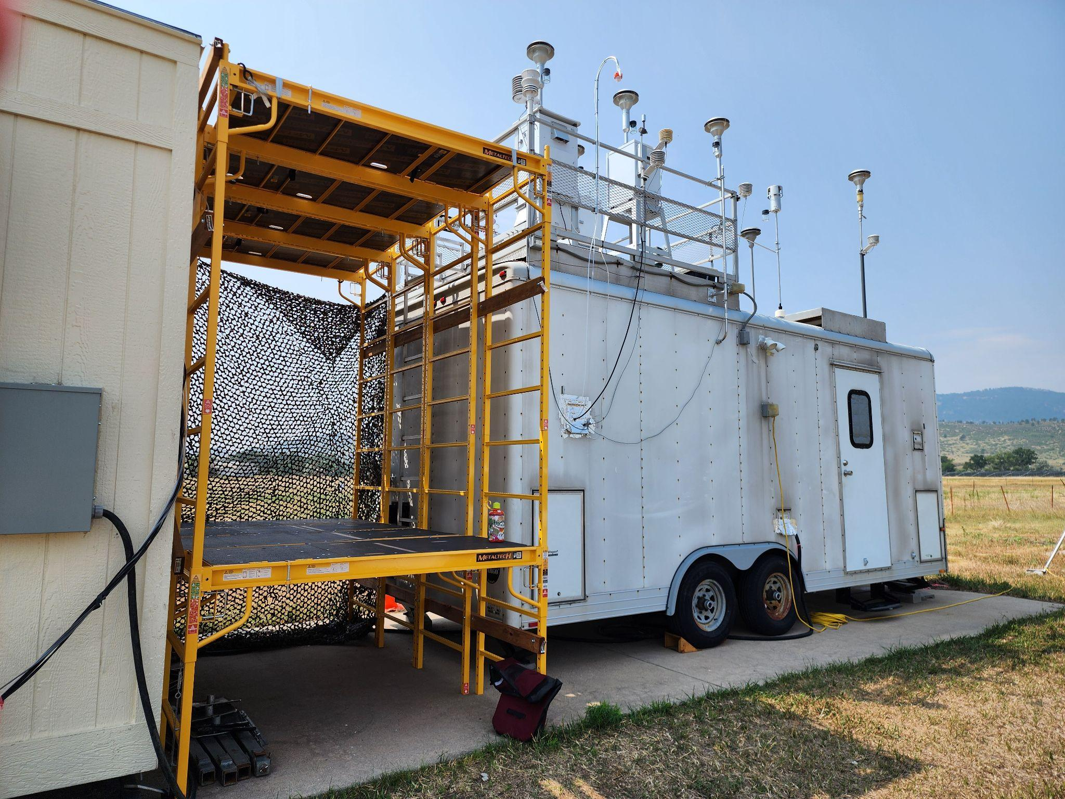

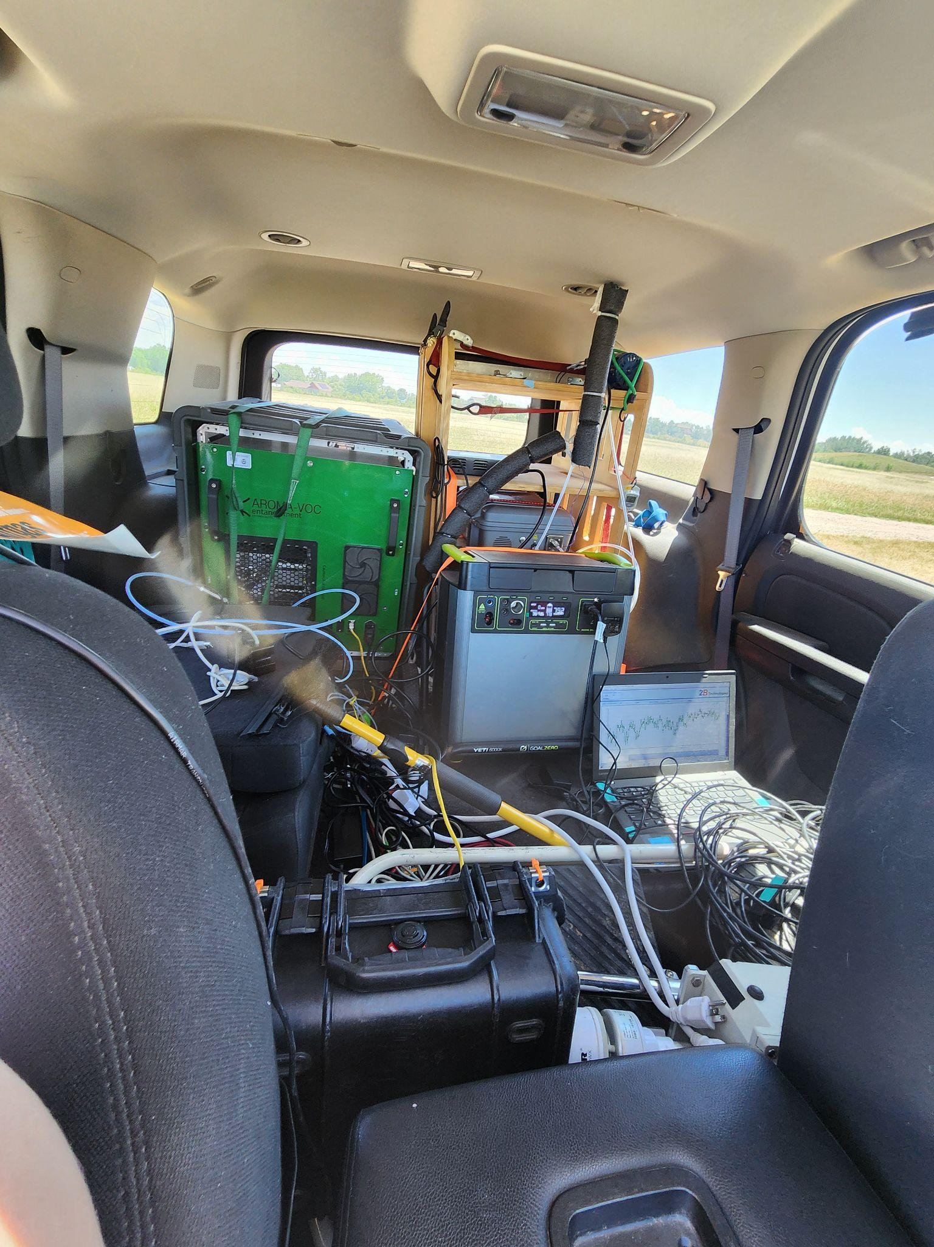
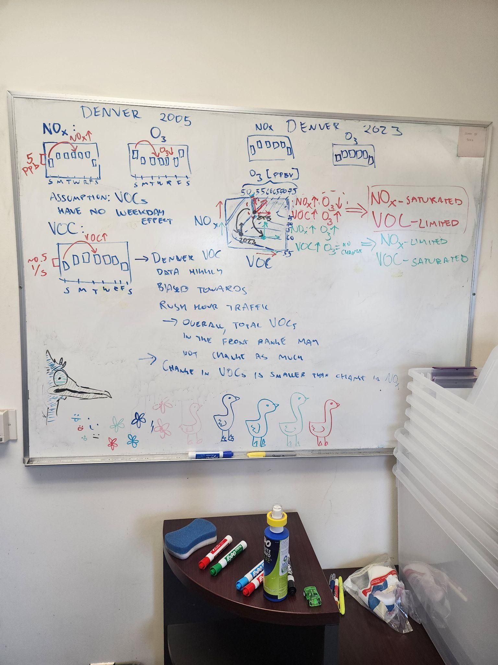
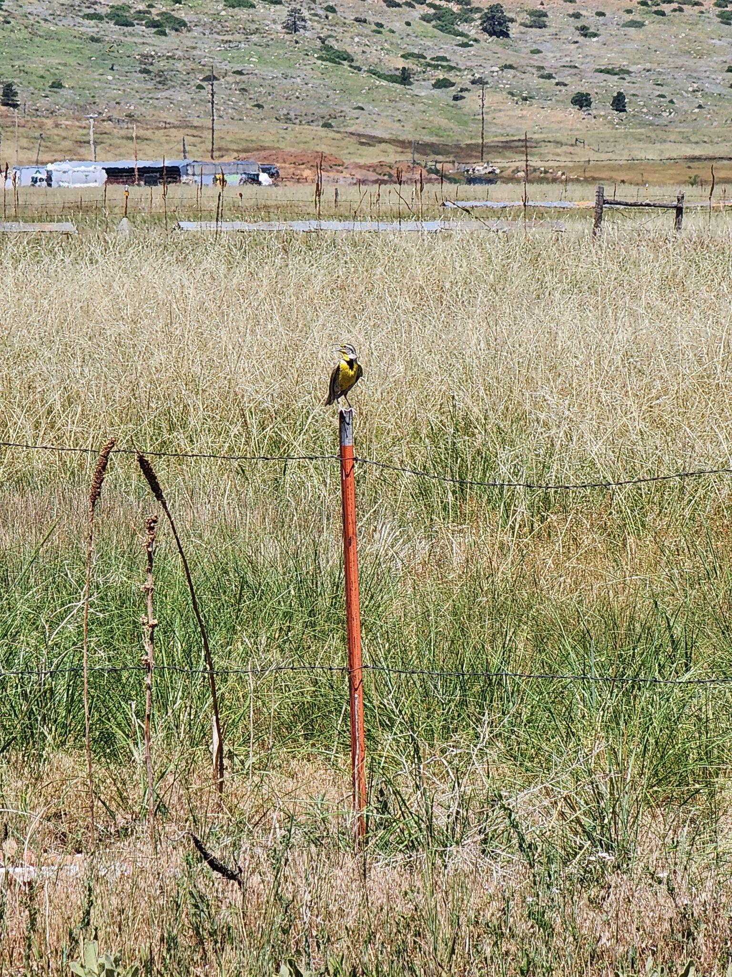

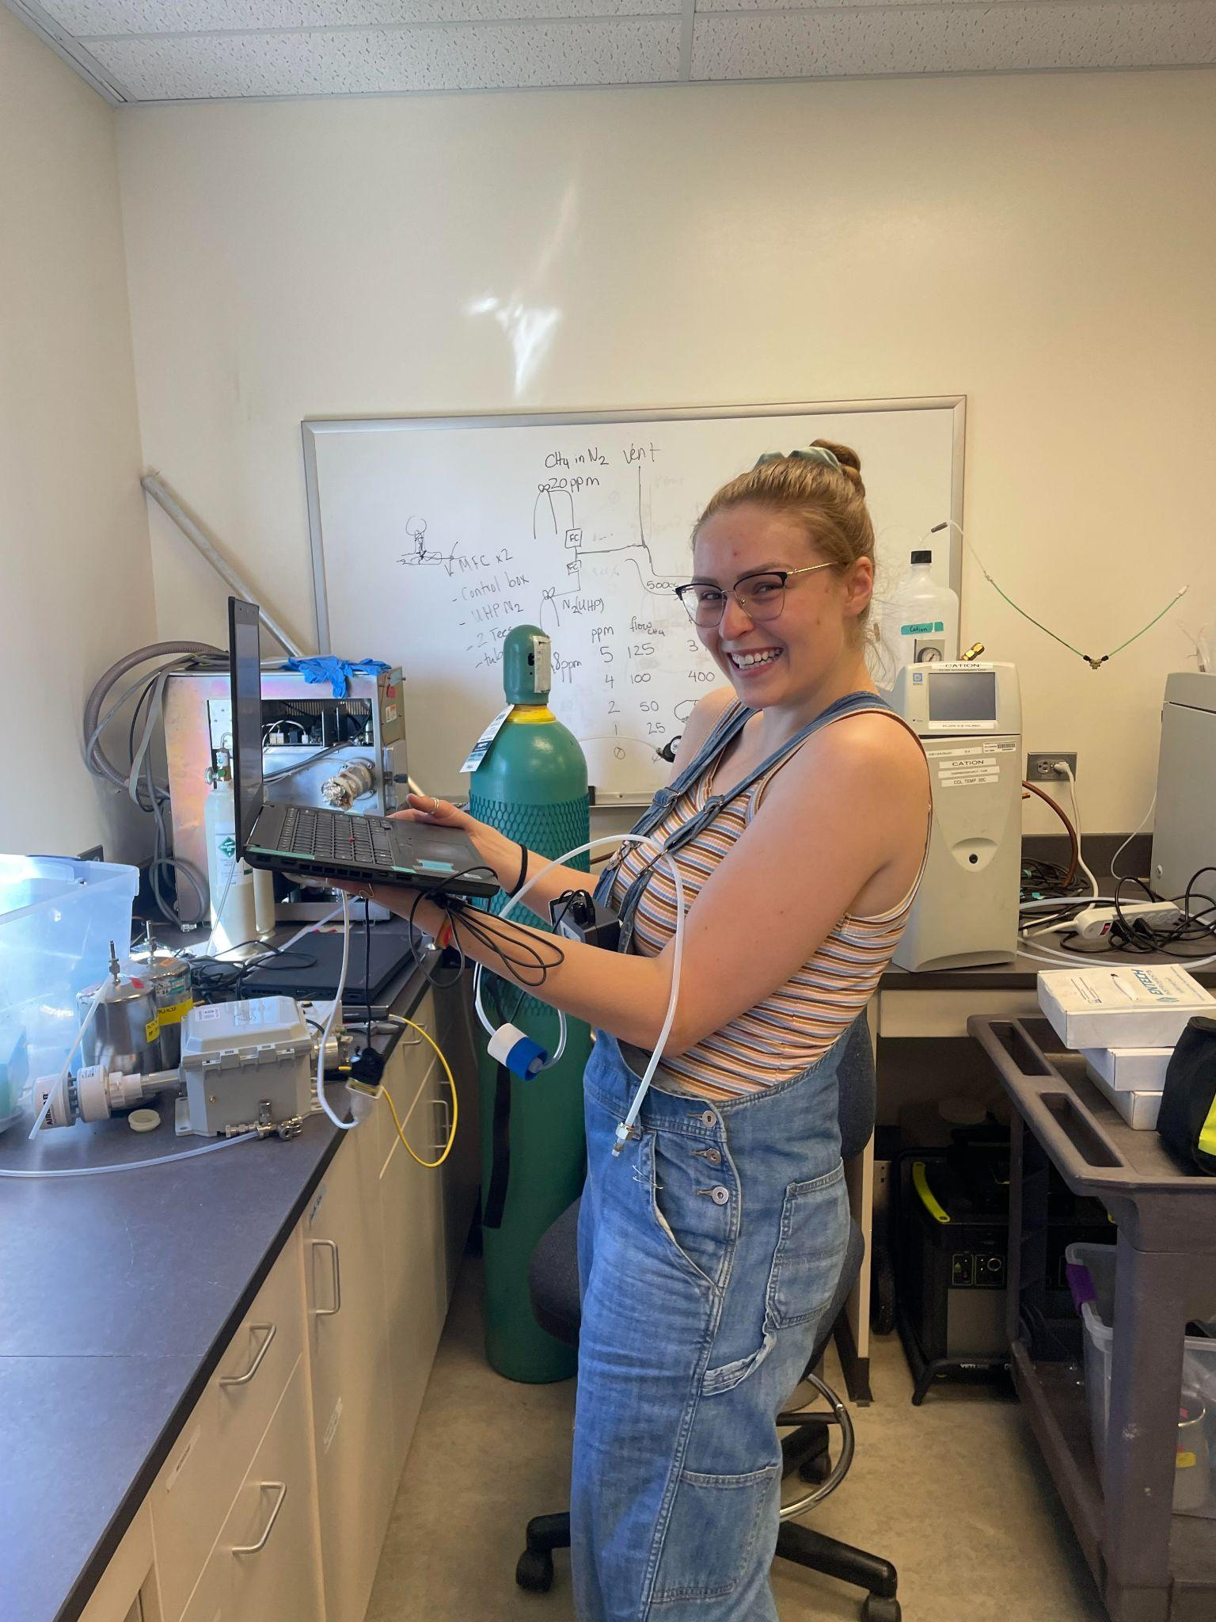
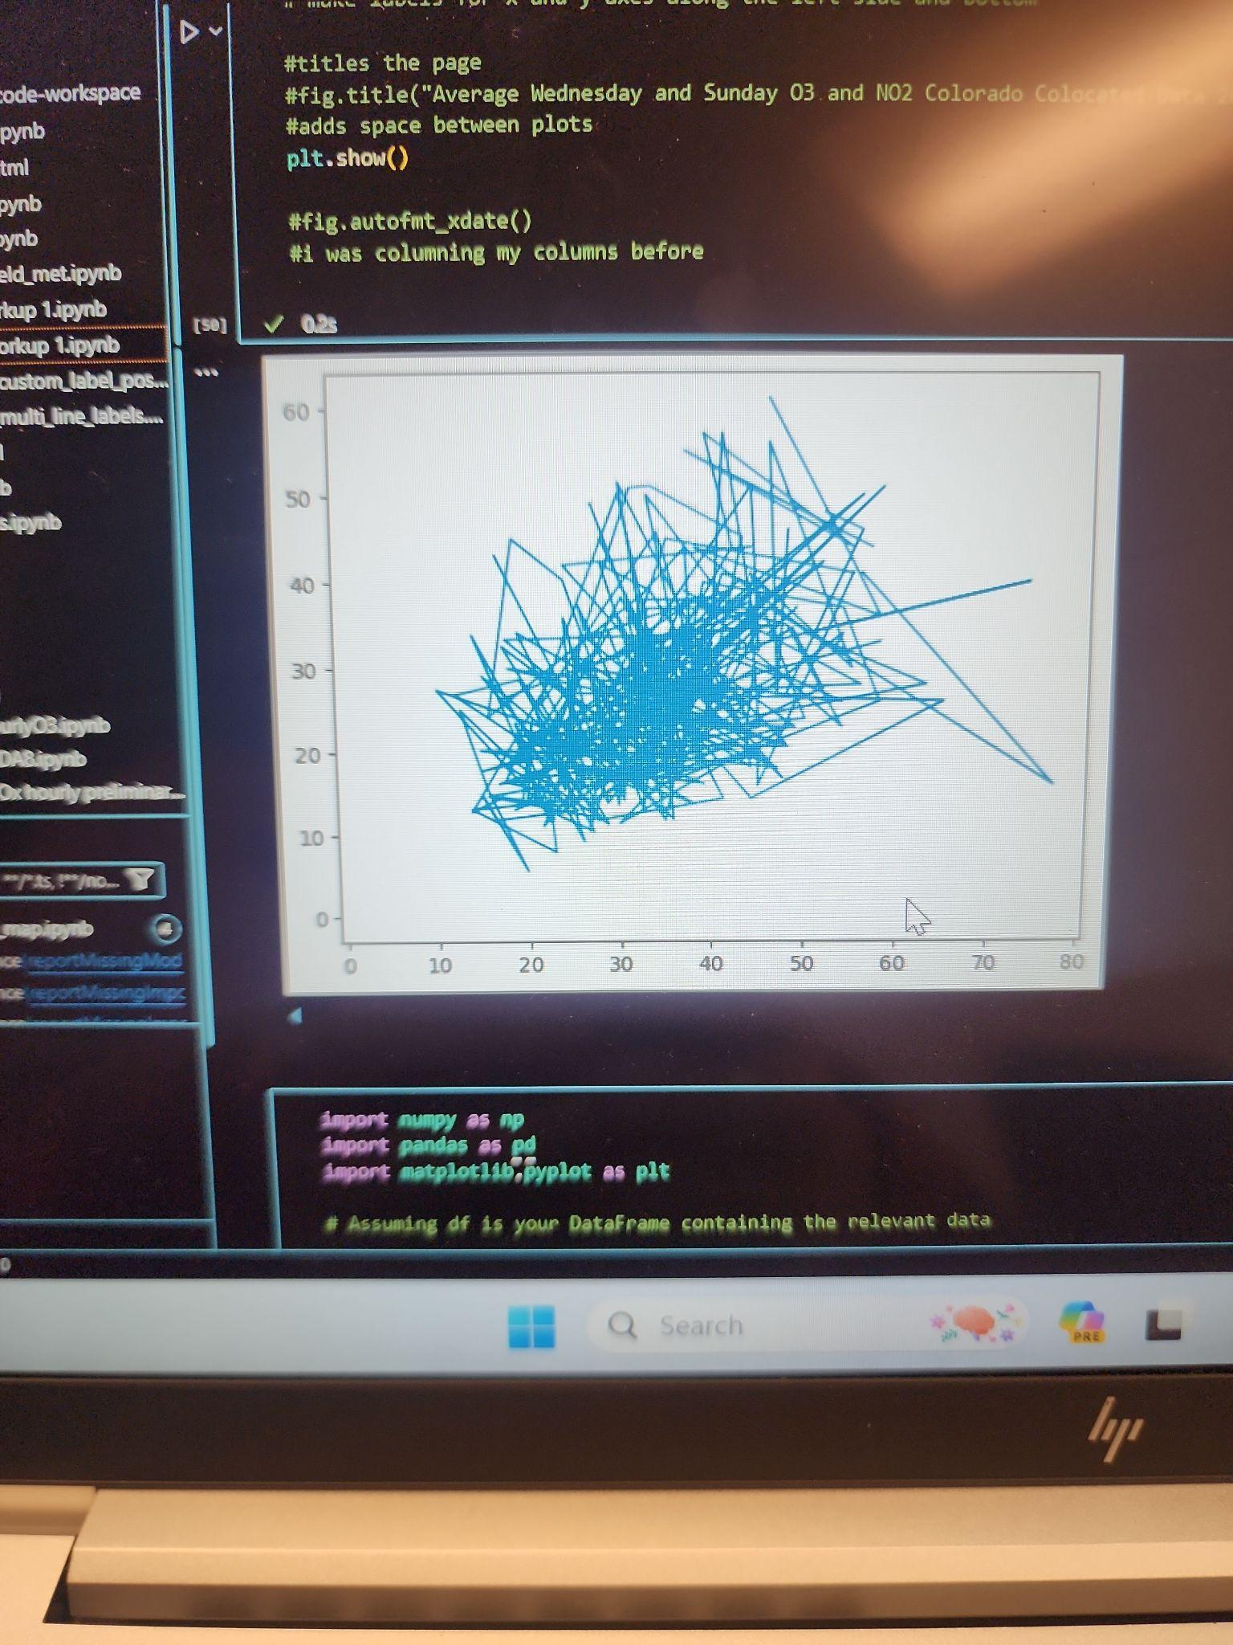
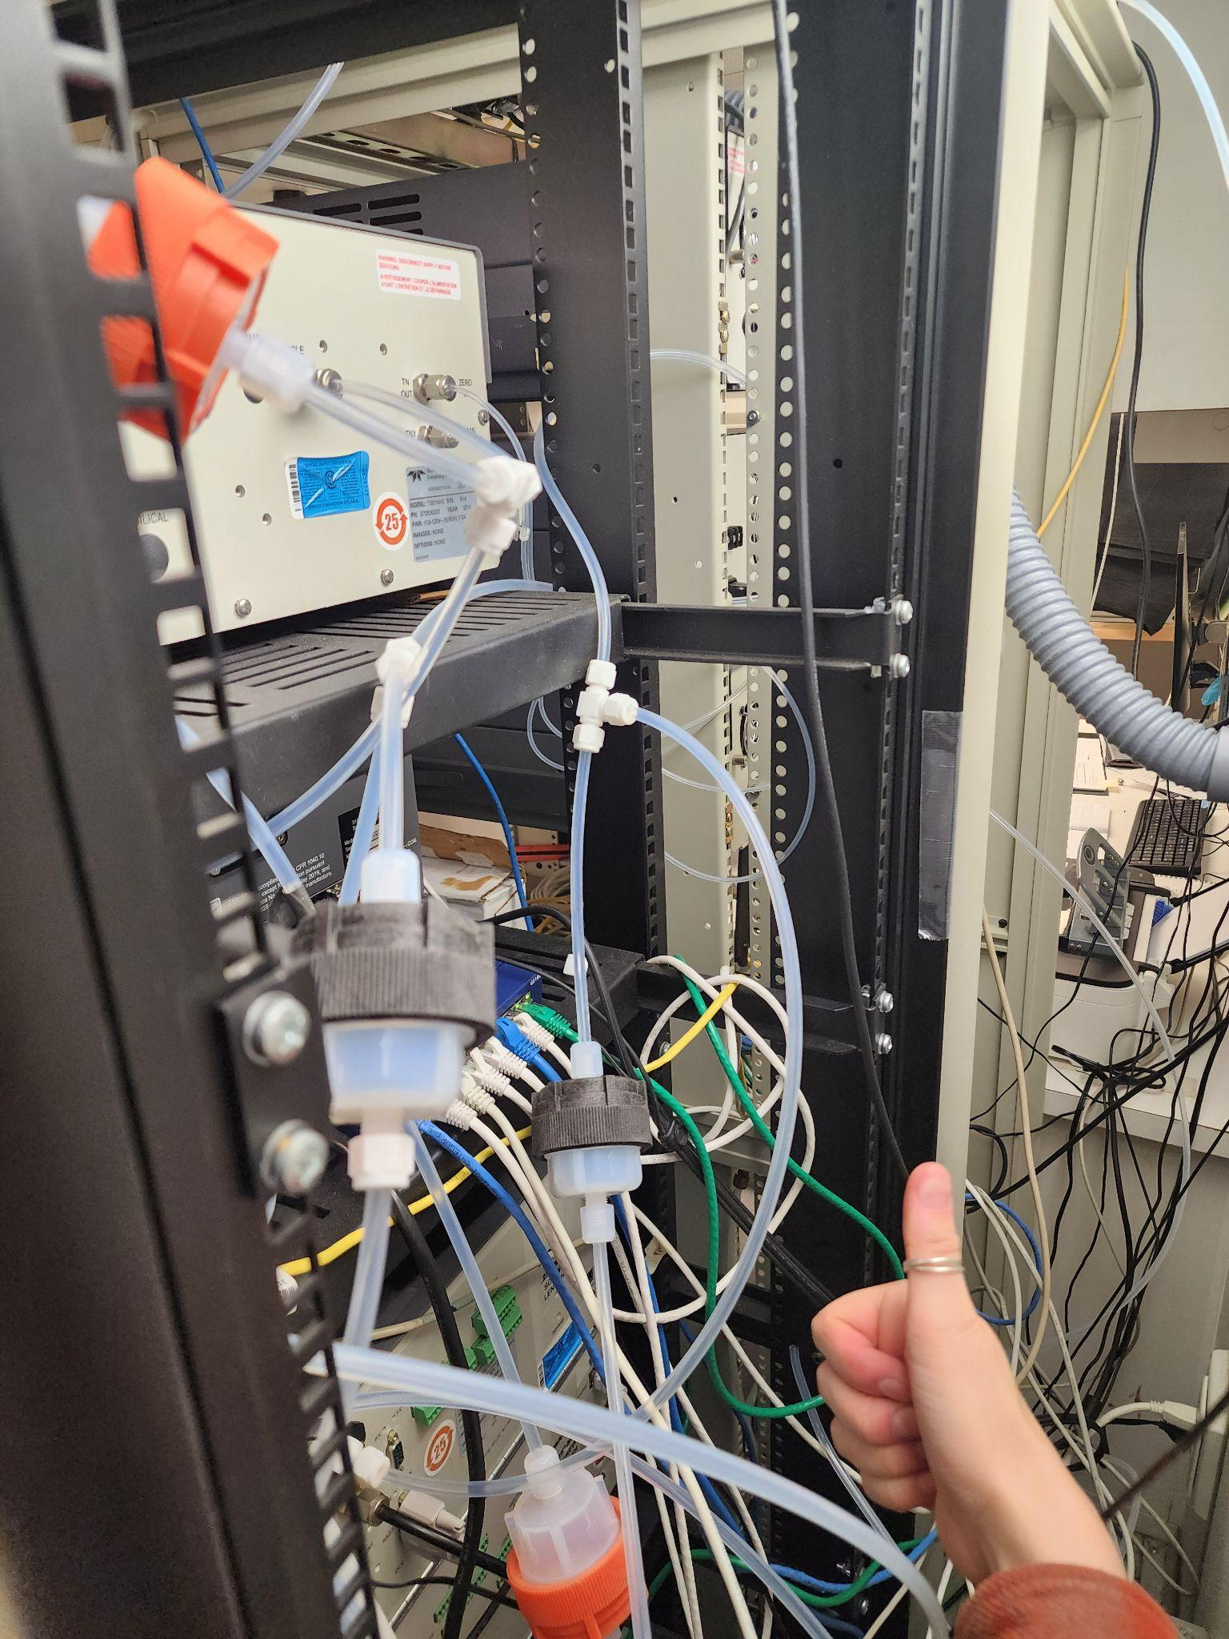
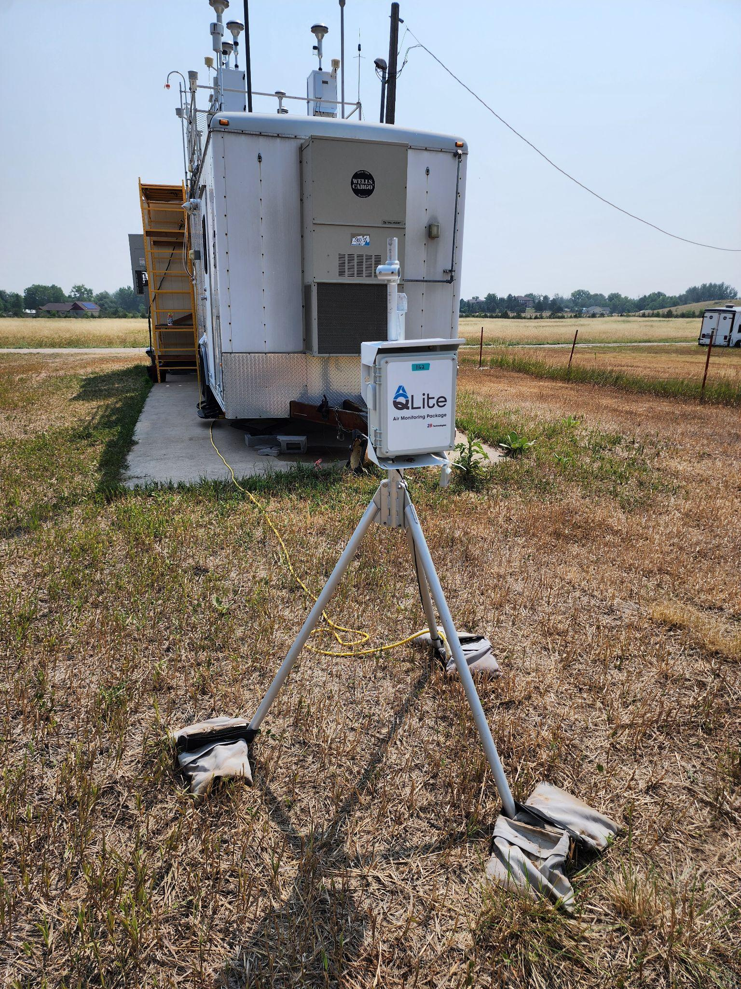
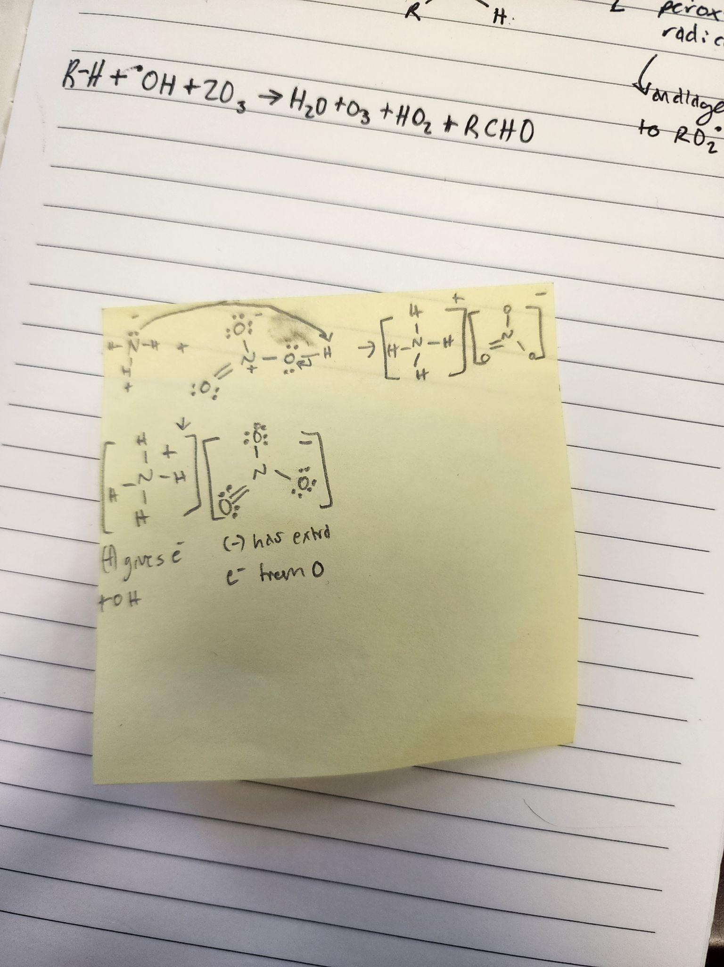

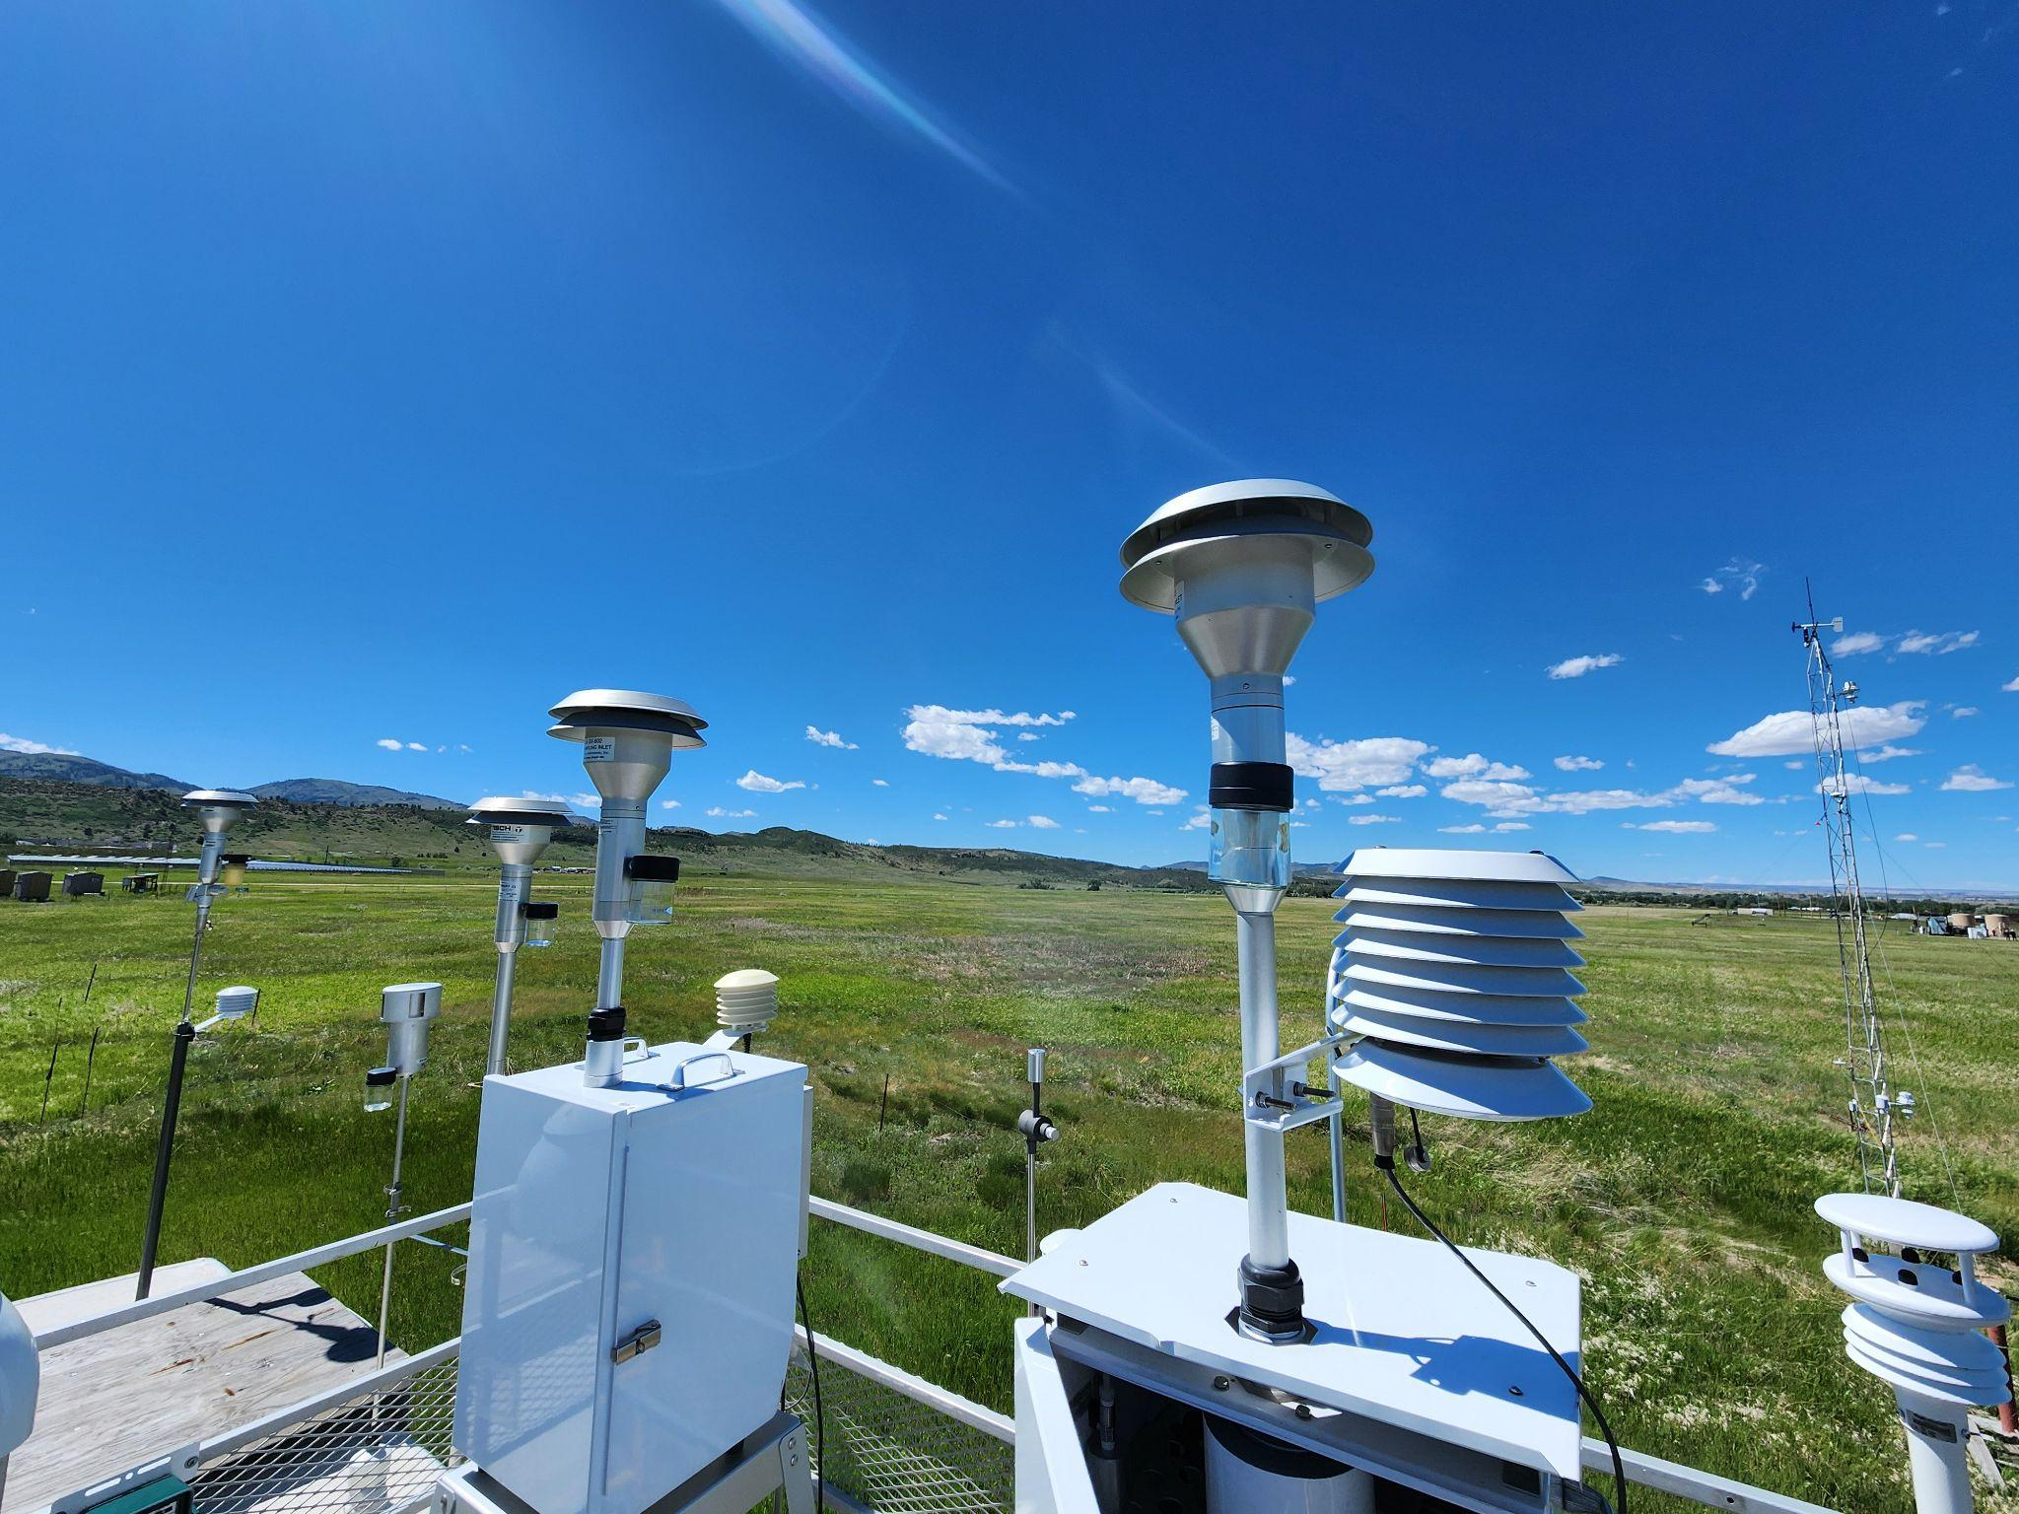
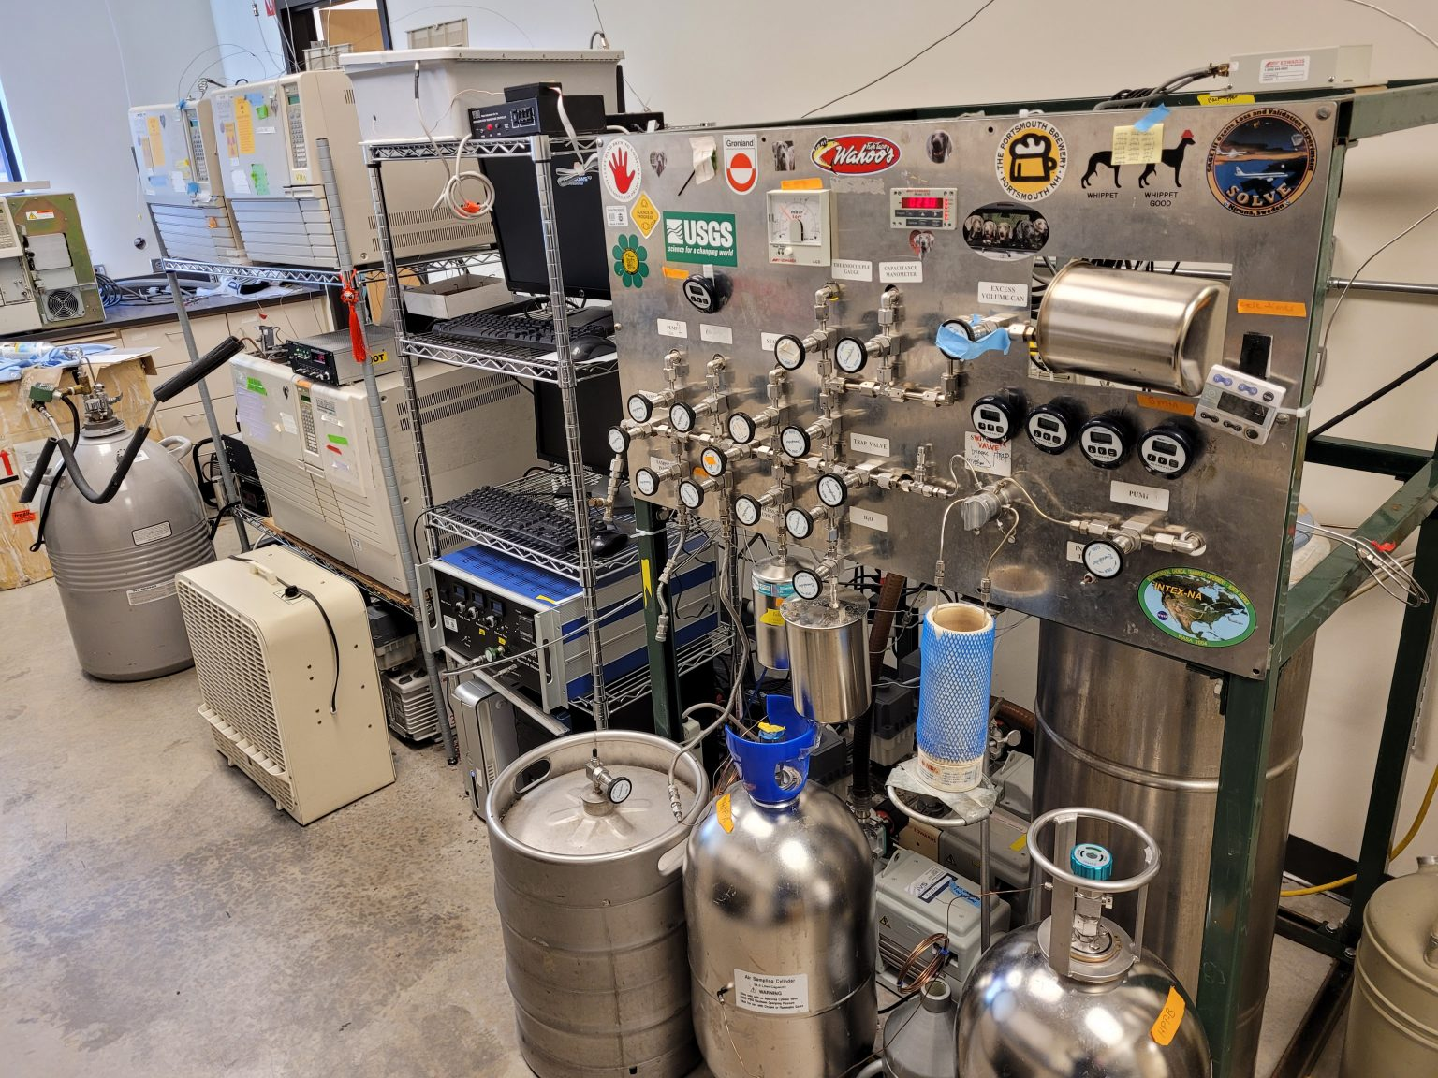
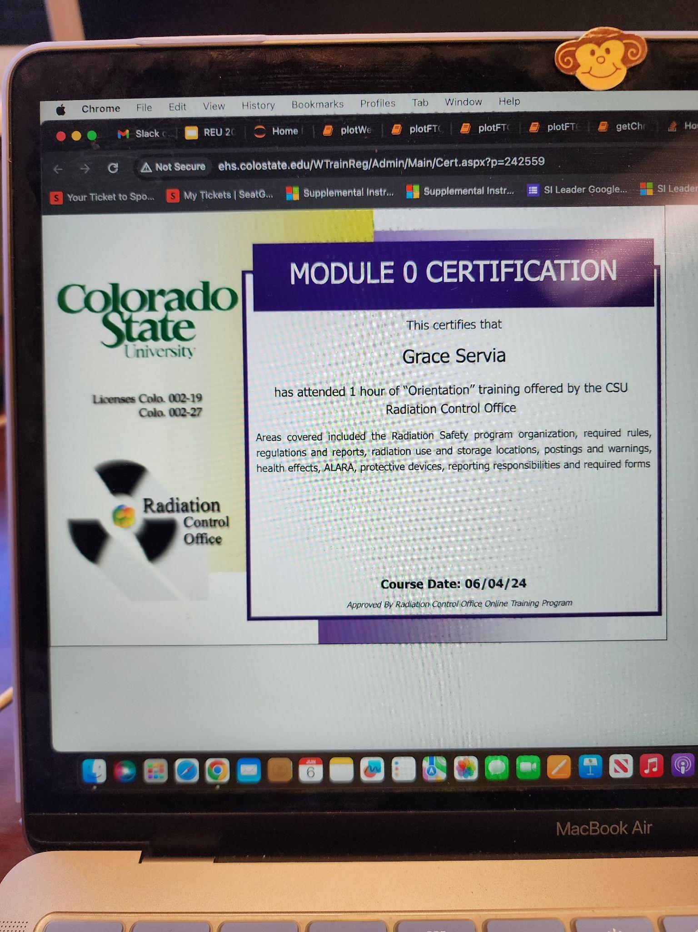
Thank You
Department of Mathematics and Statistics
Department of Chemistry and Biochemistry
Andrey, Amy, Jeff, and all of Collett Lab!
Dr. Melissa Burt and Dr. Charlotte DeMott
This work has been supported by the National Science Foundation Research Experiences for Undergraduates Site in Earth System Science at Colorado State University under the cooperative agreement No. AGS-1950172
Notes:
A weekday-weekend effect develops despite decreasing NOx concentrations!

Slide 15
Notes:
What's the next step
WHy haven't things changes - nox needs to keep decreasing
What is contributing to this summer's ozone?
What can I do
Why is it worse in denver

Slide 16
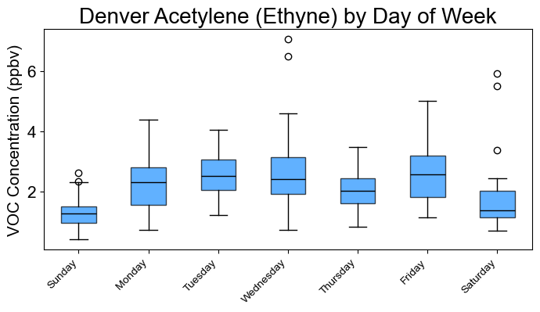
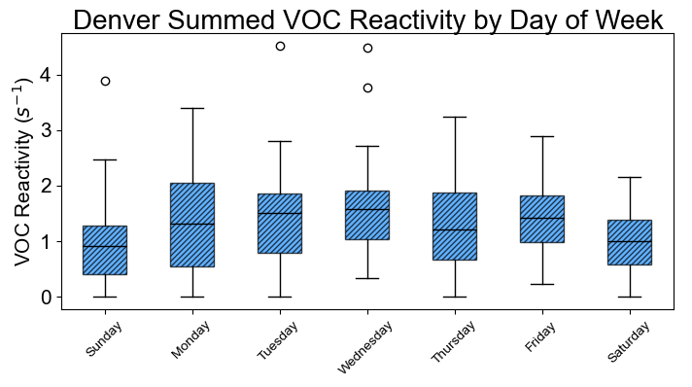
Initial VOC Workup
Source-specific VOC tracer compounds were analyzed at different locations
Urban VOCs also exhibit a Weekday-Weekend effect
How can we conclude that O₃’s behavior is not a result of VOCs?
A more thorough and lengthy analysis is needed
15
Data: CDPHE 2012-2022

Slide 17
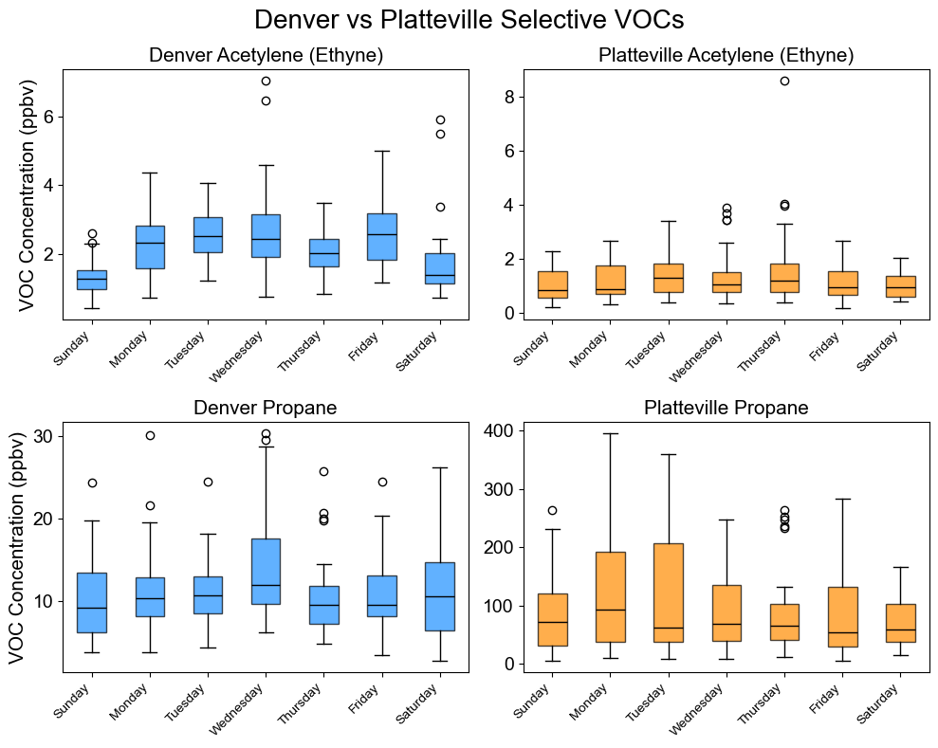
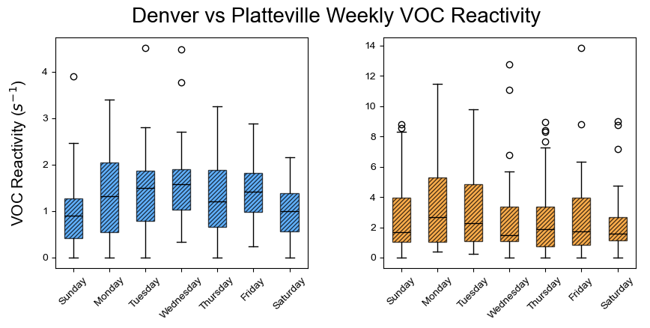
VOC Tracer Compounds by Location
Comparison between tracer compounds in urban vs. oil and natural gas locations may also be performed
16
Data: CDPHE 2012-2022

Slide 18
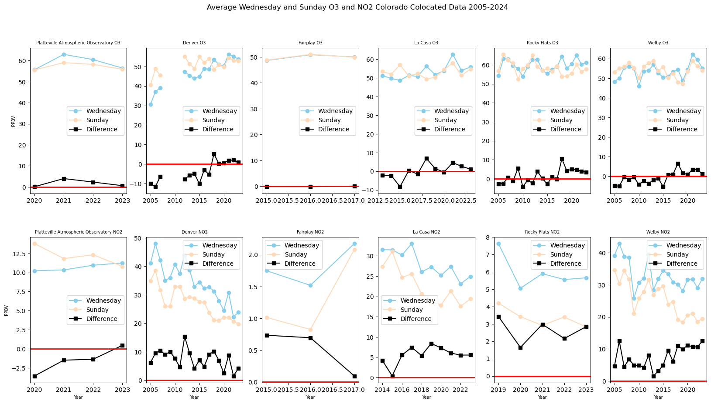
NOx Weekday-Weekend Trends
Weekday-Weekend NO_{x} Trends
17
Data: CPDHE 2005-2023

Slide 19
Establishing Exceedance
Value to compare
to attainment standards
daily maximum
8 - hour concentration
(MDA8)
annual 4th highest MDA8
3 - year average
18
Simon et.al, 2024
Notes:
https://www.researchgate.net/figure/Simplified-tropospheric-ozone-formation-schema-Ryerson-2001_fig1_361987018

Slide 20
O₃ Chemistry
Radicals (OH, HO₂, RO₂) are needed to form O₃
In NO_{x}-saturated (VOC-limited) environments, radicals are removed by reaction with NO_{x}
In NO_{x}-limited (VOC-saturated) environments, radicals are removed by self-reactions
In NOx - saturated (VOC-limited) environments (2005-2016), excessive amounts of NO_{x} in the atmosphere terminate radicals that drive O₃ production reactions
In NOx - limited environments (2017-2023), NO_{x} in the atmosphere contributes to the radicals that drive O₃ production reactions
VOCs
OVOCs
NO₂
HO₂
HNO₃
OH
HO₂
H₂O₂
NO_{x}-saturated (VOC-limited)
NO_{x}-limited
(VOC-saturated)
NO₂
NO
O₃
19
Diagram: Andrey Marsavin
Notes:
https://www.researchgate.net/figure/Simplified-tropospheric-ozone-formation-schema-Ryerson-2001_fig1_361987018

